Slide 1
Hospital Management System
Presented by
2349
2344
2341

Slide 2
A Quick overview:
A Hospital Management System (HMS) is a comprehensive software solution designed to streamline and automate various administrative and clinical tasks within a healthcare facility. It integrates different functions and processes to ensure smooth operations and improved patient care. The scope of our project includes addressing key aspects of hospital management such as:
Patient records management: Storing and organizing patient information, including their personal information (email, phone number) booking information, etc.
Doctor records management: Storing and organizing Doctor information, including their personal information (email, phone number) and the appointments they have lined up in the schedule.
Appointments and scheduling: Managing appointments for patients, doctors, and other healthcare staff to optimize workflow and minimize waiting times.

Slide 3
Objective and goals:
Implementing a centralized database for patient information to ensure data integrity and accessibility.
Developing an intuitive user interface for easy navigation and efficient data entry.
Automating appointment scheduling to minimize wait times and optimize resource allocation.
We aim to reduce administrative burdens and minimize manual tasks through automation, thereby increasing productivity and resource utilization.
·

Slide 4
Extensions which were needed to be installed:
Flask-SqlAlchemy:
SQLAlchemy provides an ORM (Object-Relational Mapping) system for working with relational databases in Python, and Flask-SQLAlchemy makes it easy to use SQLAlchemy within Flask projects. It simplifies database interactions by providing a high-level API for defining database models, executing database queries, and managing database connections.
Flask-login:
Flask-Login is an extension for Flask that provides user session management, including user authentication and authorization. It simplifies the process of managing user sessions in Flask-based web applications by handling tasks such as user login, logout, session management, and access control.

Slide 5
What is used:
Flask
MySQL
Python
HTML & CSS

Slide 6
Working of the project in brief:
A user will either sign up(if they are new users) as a patient or a doctor according to their role,
If they already have an account, they can just log-in.
Logged in as a patient:
You can check the departments available for treatment, you can book appointment with a doctor.In edition you can check,edit or even delete previously made bookings.
Logged in as a Doctor:
You can keep a track of the appointments scheduled not just for you but also for the other doctors.In edition you will have a list of all the patients using the app.

Slide 7
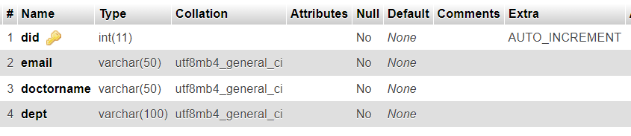
Database:hmdbms
There are 4 table in the database:
TABLE doctors:

Slide 8
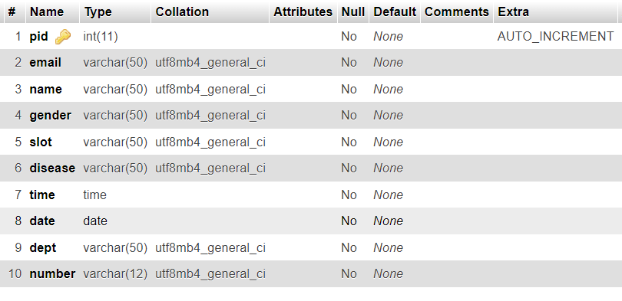
TABLE patients:

Slide 9
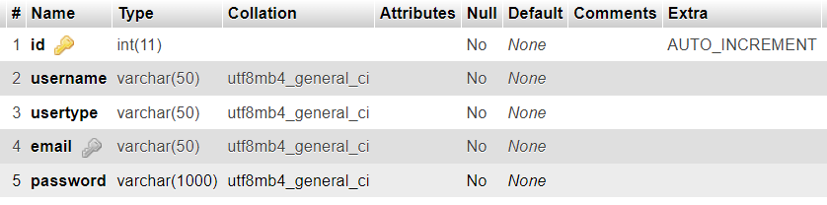
TABLE users:

Slide 10
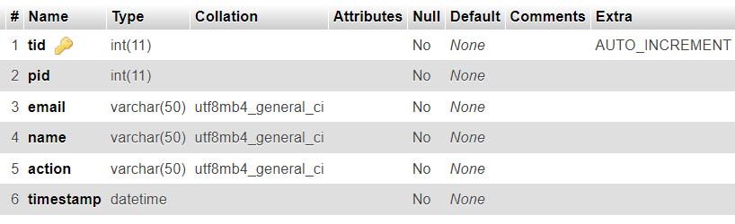
TABLE trigr:

Slide 11
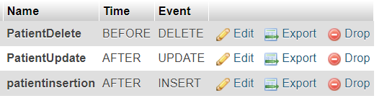
TRIGGERS set on TABLE patients:
On trigger the data from table patients is saved in table trigr.

Slide 12
Future Scope:
Inventory management: Tracking and managing hospital supplies, medications, and equipment to ensure availability and prevent stock outs or overstocking.
Billing and invoicing: Handling financial transactions, insurance claims, and billing processes accurately and efficiently.
Patient records management: Edition fields can be added to patient information, including medical history, diagnoses, treatments, and test results.

Slide 13
THANK YOU :)

